Slide 1
Smart Research Agent AI Powered Reports created in seconds!
For students, teachers, professors, researchers, entrepreneurs, engineers, doctors, startups teams and everyone else enthusiastic about recent AI inventions!

Slide 2
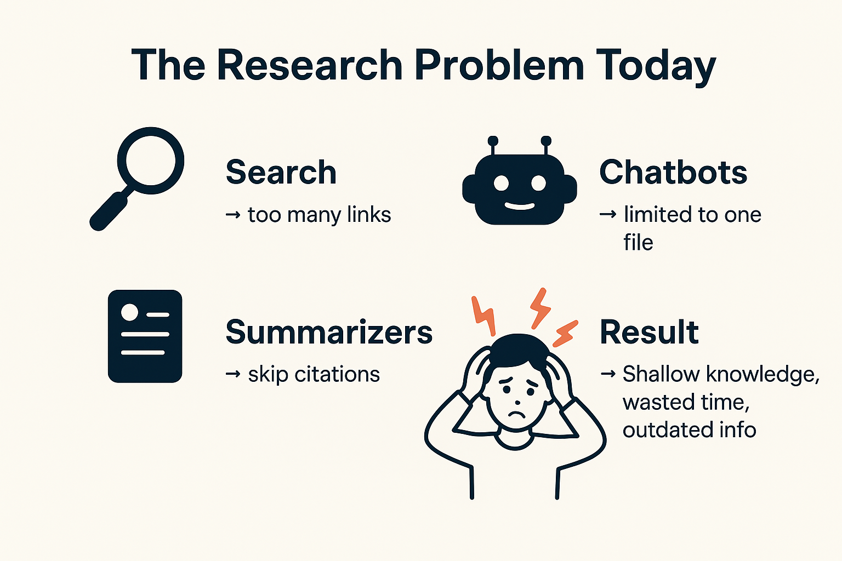

Slide 3

Objective
Build a Research Assistant Agent that:
Takes a question as input.
Searches across uploaded files + live data source.
Summarizes into a structured report with citations.
Keeps itself updated with fresh information (via Pathways).
Tracks usage + billing per report (via Flexprice).

Slide 4
Solution Overview
Smart Research Agent = Frontend + Backend + Dashboard
Frontend App: User enters question, views reports & usage counter.
Backend Pipelines: Ingest data (Pathway), run AI agent, structure reports.
AI Agent: Generates concise, evidence-based summaries with trustable citations.
Dashboard: Shows reports, usage count, cost, ingestion freshness.
Billing: Pay-per-report using Flexprice.

Slide 5
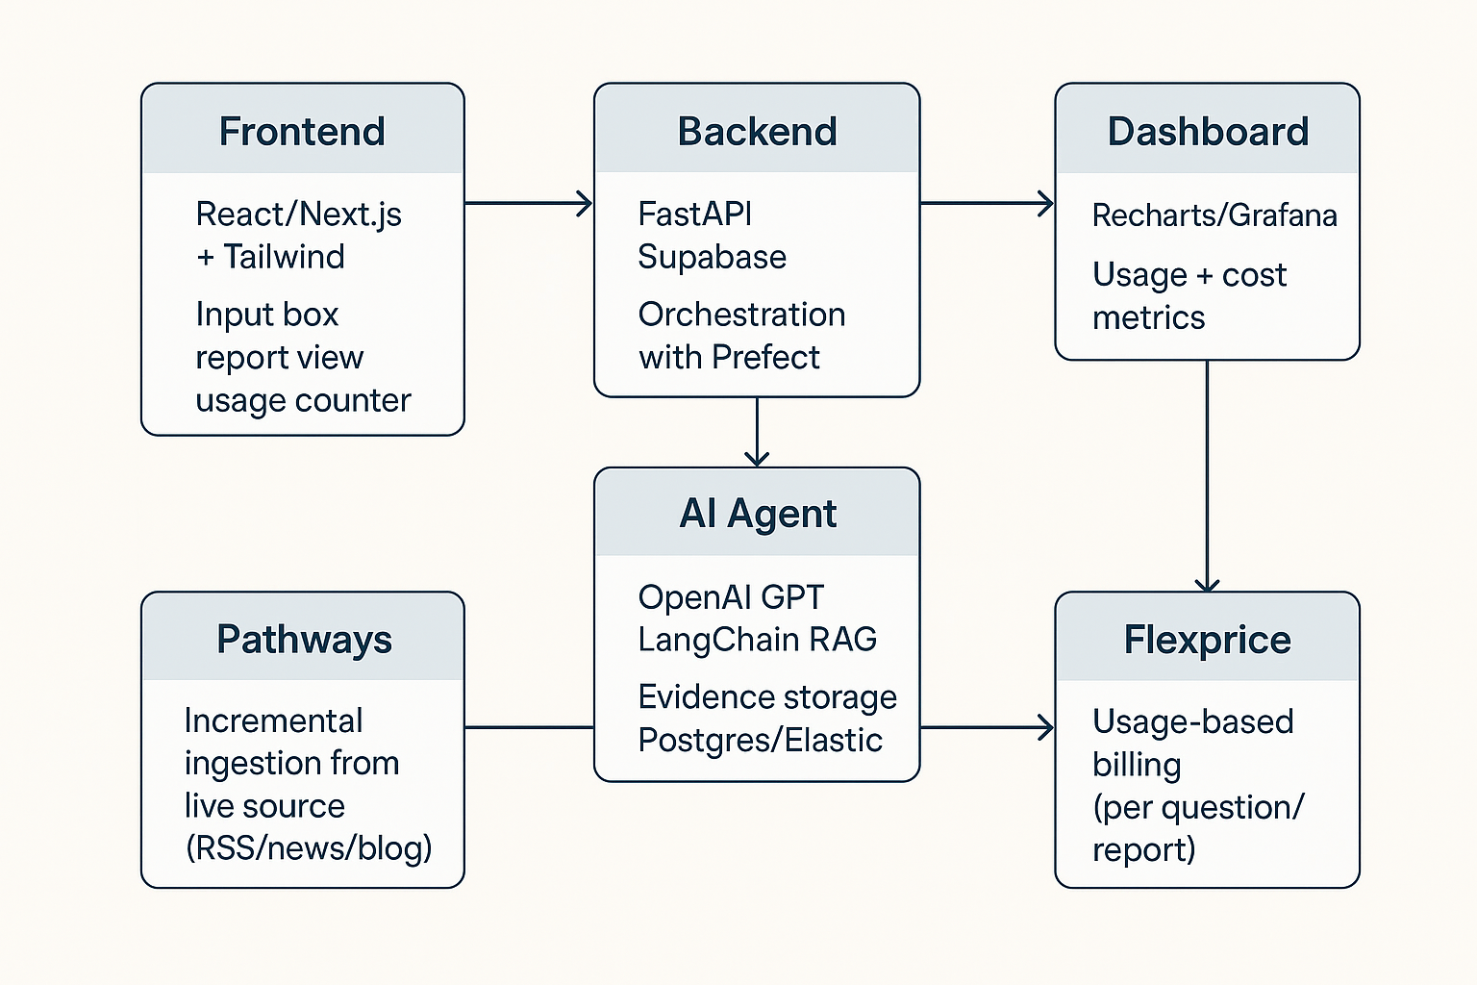
Architecture

Slide 6

How It Works (Demo Flow)
User asks: “Recent studies on EV battery efficiency?”
Pathways ingestion: Pulls new blog/news updates.
AI Agent: Combines evidence from uploaded files + live feed.
Report Generated:
Summary: “AI improves battery performance by 20%...”
Citations: Source links, timestamps.
Confidence score.
Billing: Report = 1 credit deducted (via Flexprice).
Dashboard: Shows usage, costs, freshness.

Slide 7
Looking Ahead
Features:
Structured reports with citations + confidence.
Incremental ingestion with Pathways.
Usage-based billing with Flexprice.
Dashboard with insights, sources, and cost tracking.
Benefits:
Saves time → no more endless Googling.
Provides trustable answers → citations included.
Always fresh & updated.
Scales to SaaS → students, startups, enterprises.
Future Roadmap:
Multi-source ingestion (journals, APIs, PDFs).
Team collaboration features.
Multi-language support.
Impact:
Democratizes research.
Empowers students, educators, innovators.
Creates a scalable SaaS tool with per-usage billing.

